Slide 1

Amazon Reviews
Team Mount Lincoln:
Nicholas Cottrell, Jenny Kao, Molly Pagden, Upasana Rangaraju, Isaac Smith

Slide 2
Project Scope
We looked at over 130+ million Amazon Text Reviews of various different consumer products
Once we parqueted the file in our Amazon S3 bucket, we able to do some analysis on the different global marketplaces that reviews were coming from
Because of the diversity of our product categories over this huge dataset, we chose to do our deep dive analysis on the Electronics product category.

Slide 3
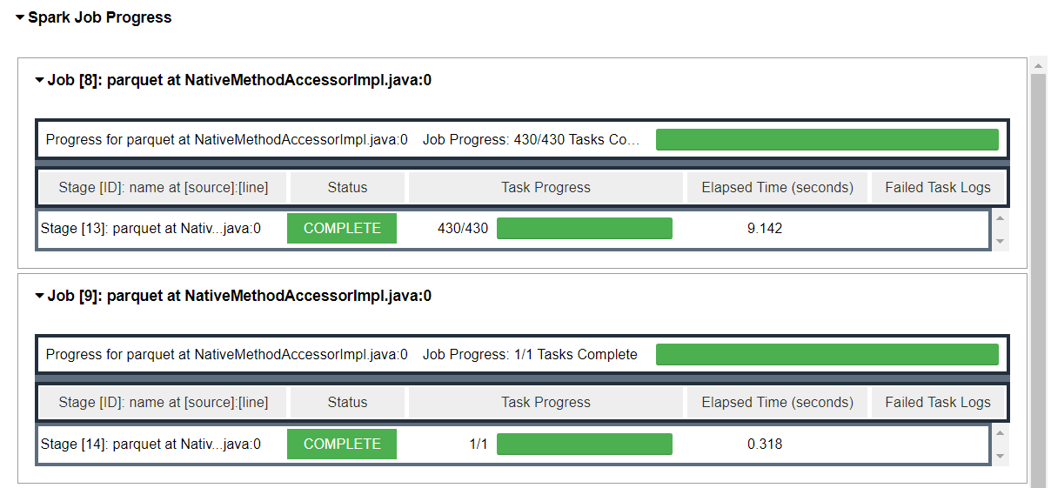
S3 Bucket and connecting to the EMR Master Node
We were able to navigate to the EMR Leeds Master Node to deploy our code
It only took about ~2 minutes to load our huge dataset (259,418 kb) into our Jupyter Notebook
From there, conducting analysis was incredibly efficient

Slide 4
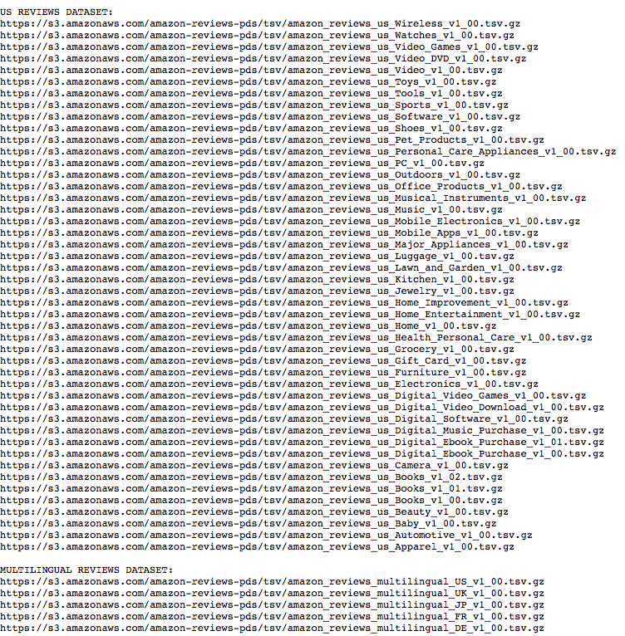
Amazon Dataset & Format
A collection of reviews written in Amazon marketplace and metadata from 1995 to 2015. ( Over 130+ million data )
Two file type: Text & Parquet file
To improve the query performance, Amazon further partitioned on its S3 by product_category. Allowing queries using a WHERE clause on category to read specific data. Also reducing query cost.

Slide 5
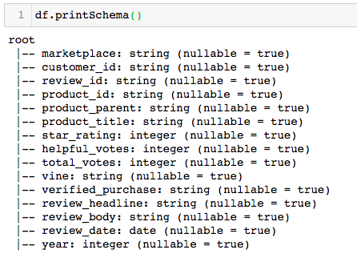
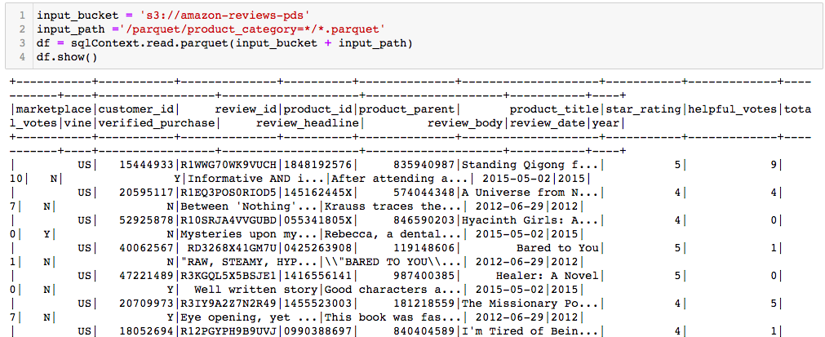
Brief Look at the Amazon dataset
Connect to Amazon’s S3 bucket located the AWS US East Region
Amazon Glue: Crawler feature to automatically discover the data and require tabled you will later query.
Total of 15 columns.

Slide 6
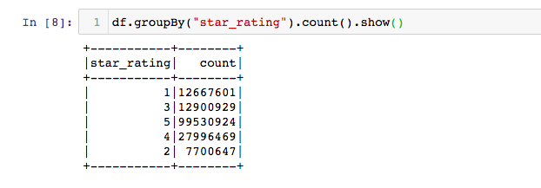
Star Rating from the entire Amazon Dataset
Total 21,460,962 products with 160M+ reviews.
Product review rating above 3 star for all categories: 79%

Slide 7
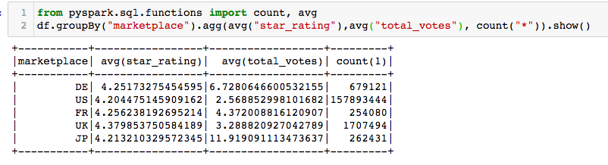
Star Rating & Votes by Marketplace
Total of five different market: Germany, United States, France, United Kingdom, Japan.
Most of amount of review counts : US
Similar average star-rating for all market place: Around 4.2-4.3 stars
Japanese consumers tends to find reviews more useful than than other markets.

Slide 8
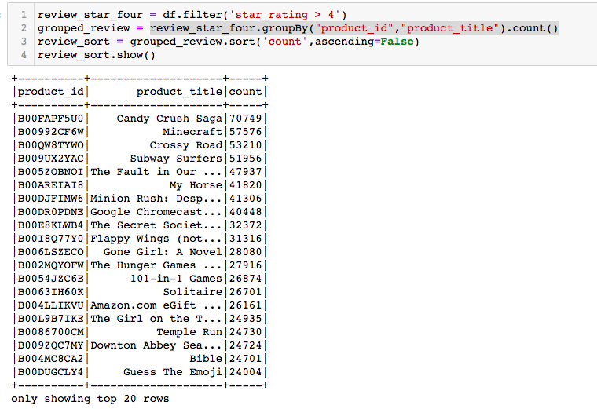
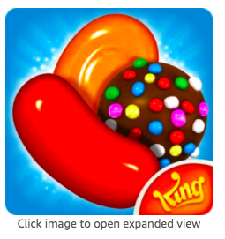
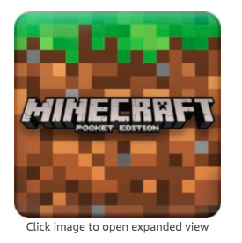

Product with the most amount of 5 star-rating.
Consumers tends to give mobile app reviews more often.
Mobile apps with the most amount of 5 star reviews are Candy Crush, Minecraft & Crossy Road.

Slide 9
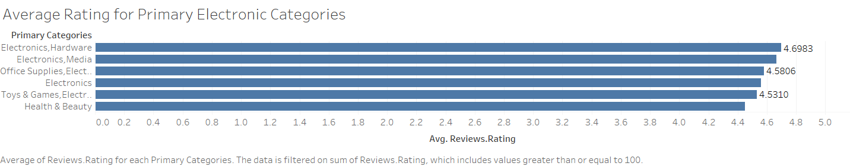
Average Rate for Electronics
Most Reviews for the Electronic Product Categories were high, in the 4-5 star category
This could be because Amazon vets vendors who sell electronic products highly for consumer protection

Slide 10
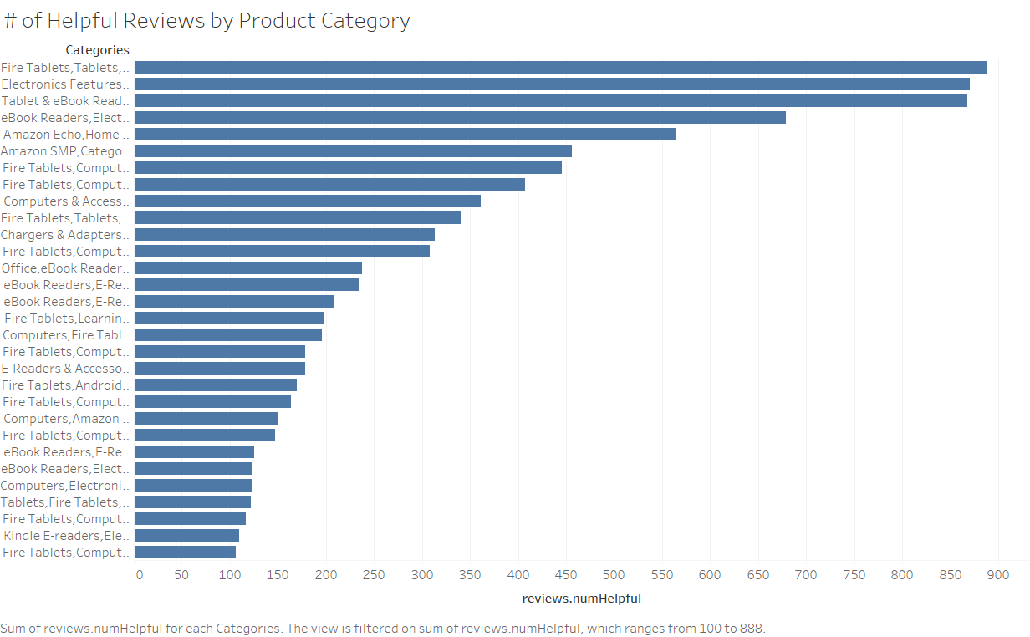
Number of “Helpful” Reviews by Top Products
Helpful reviews are reviews that other customers have marked to be informative and accurate
Tablets, E-books, and Computers had the most “helpful reviews” of any products
This could be due to the fact that shoppers heavily rely on consumer reviews to make electronic purchases, as these products are expensive, and many substitute options exist in the marketplace

Slide 11
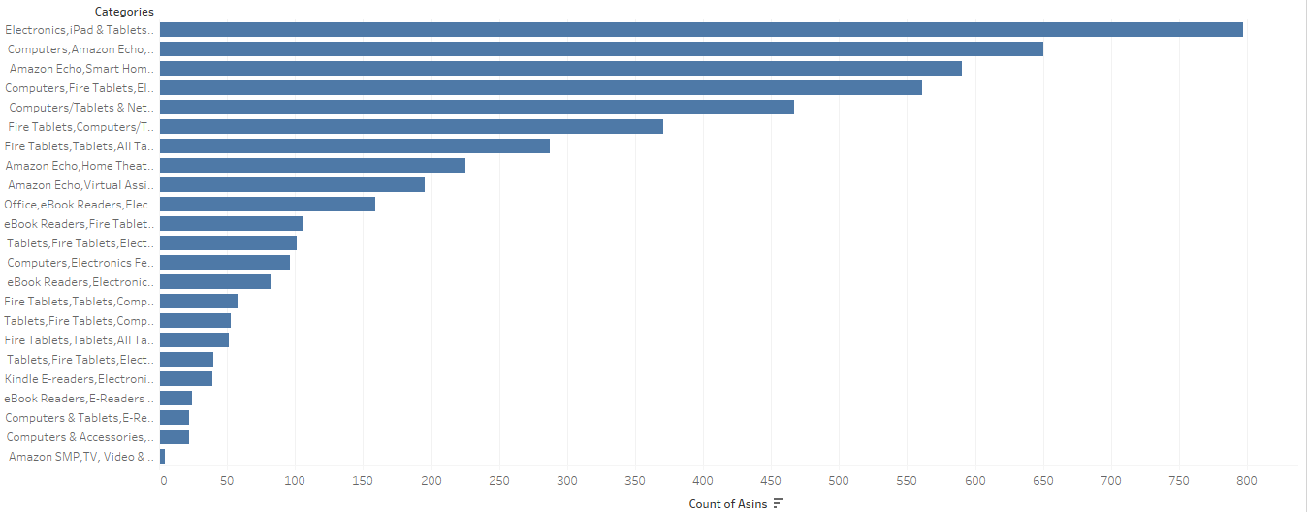
Number of Products By Category

Slide 12
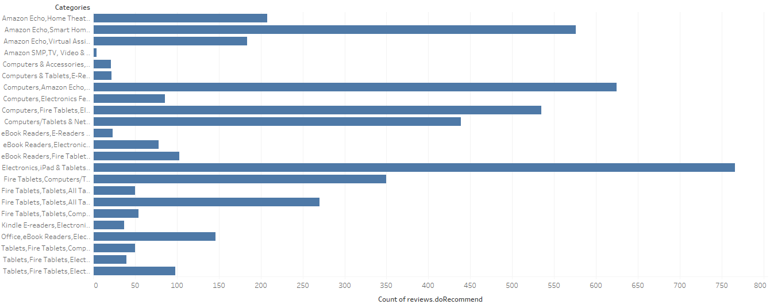
People Who Recommend a Product Category

Slide 13
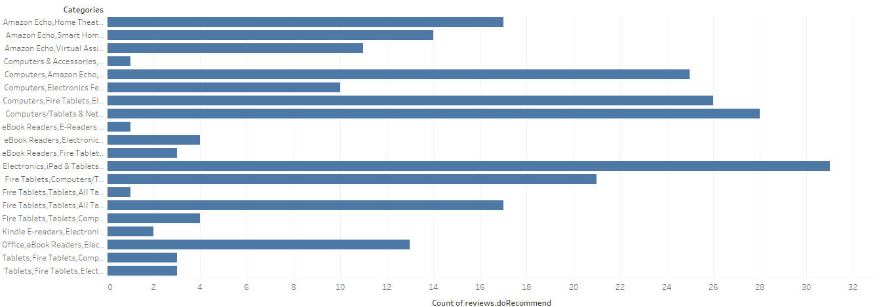
Number of People Who Don’t Recommend a Product Category

Slide 14
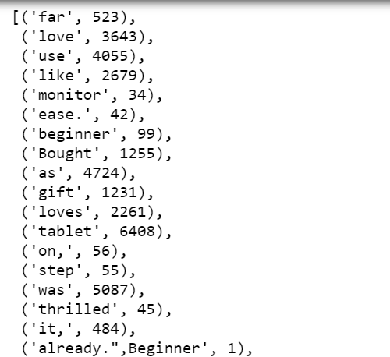
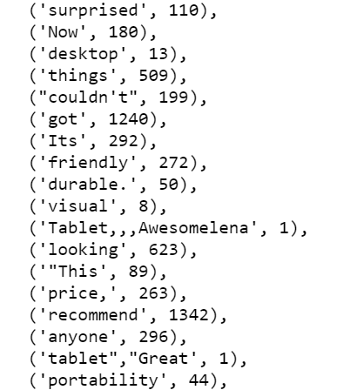
Word Count

Slide 15
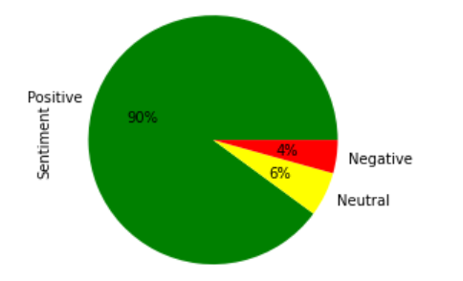
Sentiment Analysis
We ran sentiment analysis on the reviews column and found that most of the reviews have a positive sentiment.

Slide 16
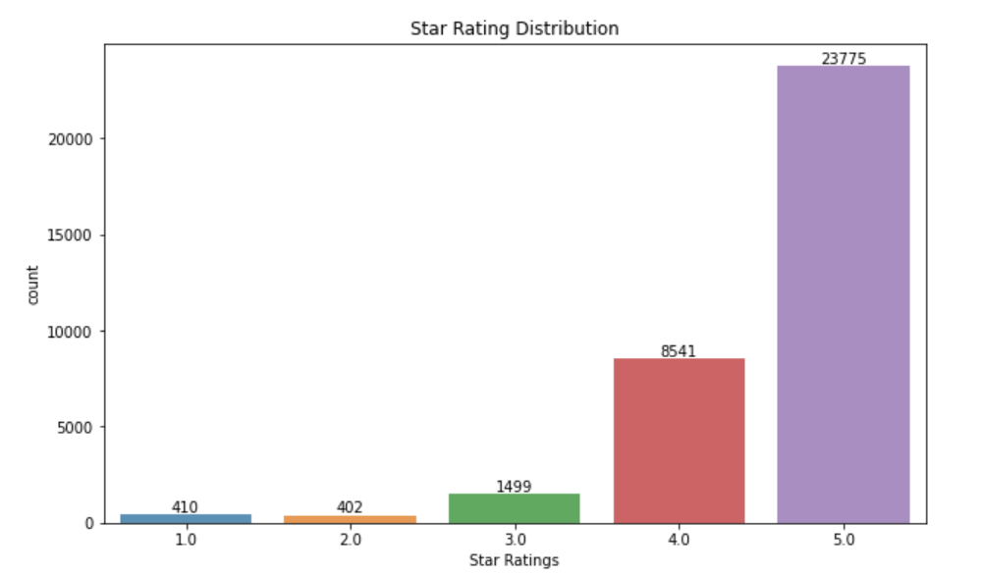
Star Rating distribution

Slide 17
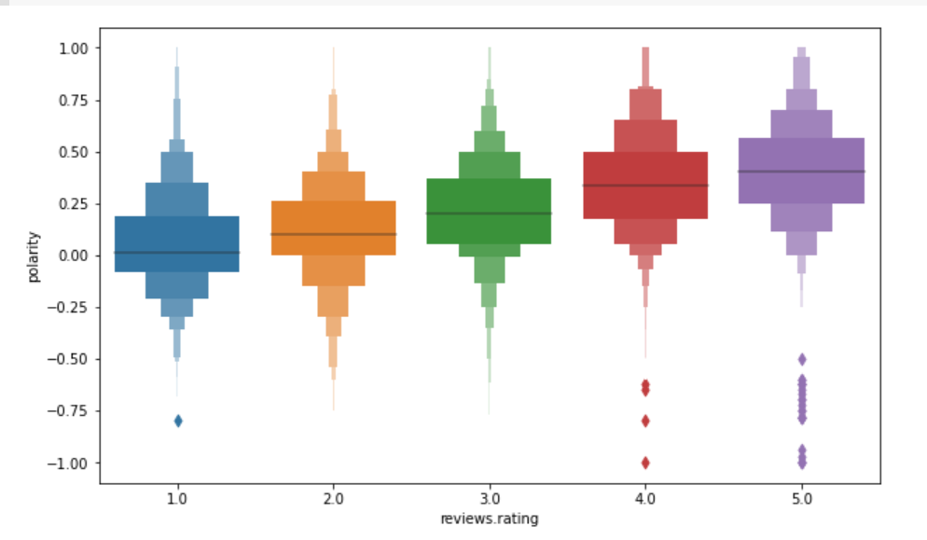
Polarity grouped by Ratings

Slide 18

Word Cloud

Slide 19
Conclusions
Amazon S3 bucket is super fast, and we were able to analyze a massive dataset in very little time.
Across the entire dataset, the vast majority of products are given a 5 star rating.
After a deeper dive into the electronics category, saw the overall perception and satisfaction of buyers
Overall: Overwhelmingly positive sentiment in the reviews for electronic products

Slide 20
Sources
https://s3.amazonaws.com/amazon-reviews-pds/readme.html
https://s3.amazonaws.com/amazon-reviews-pds/tsv/index.txt

